Slide 1

DESIGN AND DEVELOPMENT OF INTELLEGENT WIRELESS CHARGING STATION FOR ELECRIC VEHICLE

Slide 2
DESIGN AND DEVELOPMENT OF INTELLEGENT WIRELESS CHARGING STATION FOR ELECTRIC VEHICLE

Slide 3
CONTENT
1
ABSTRACT
LITERATURE REVIEW
2
3
OBJECTIVES
BLOCK DIAGRAM OF
CHARGING STATION
4
5
PROPOSED MODEL
RESULTS AND DISCUSSION
6
7
CONCLUSION

Slide 4
ABSTRACT
This paper mainly deals with the design of a proposed system to create and handle electric vehicles charging procedures based on intelligent process. Wireless Power Transmission (WPT) is a popular technology in recent years with the rapid development of electrical vehicle in new energy industry are put forward for convenient, safety and reliability of wireless charging electric vehicles. The power is transferred from a source to electric load without the need of interconnections. WPT is useful to power electrical devices where physical wiring is not possible. Wireless power charging is done by the principle of inductive coupling. Sufficient power for the battery can be transferred by the primary to the secondary without sufficient energy loss. Electric power is then transmitted to the chargeable battery which is electrically coupled to the secondary circuit through the air core transformer. The main goal is to transmit power using inductive coupling and to build the charging systems. This technology enables efficient opportunities in charging stations, for predefined routes and planned stops reducing down the time of charging. The dynamic charging will promote the use of electric vehicles and reduce petroleum fuel consumption. Bad weather conditions like rain and snow do not affect the charging capabilities of electric vehicles.

Slide 5
LITERATURE REVIEW
Wireless charging system has more simplicity, reliability and user friendliness, when compared with plug in charging systems. It can be employed in high power applications as well as plug in electric vehicles in stationary conditions. However, in the future, the focus is on clean and green energy producing zero emissions so design and manufacture of electric vehicles has led to major interest in current industry.
The main problem faced by wireless charging system is to be used only when the vehicle is parked or in stationary conditions like traffic signals, garbage’s etc. And the main challenges faced by stationary wireless charging are electromagnetic compatibility issues, low power transfer, large structure, less range and high efficiency Consumers are constantly looking for a better solution to improve the travel efficiency.
Dynamic mode of operation allows the charging of battery storage devices even when the vehicle is motion. Here the vehicles only need low volume of battery storage thus the range of transportation is able to be increased. The dynamic WCS have to face mainly two problems such as large air gap and coil misalignment. The coil alignment and air gap distance between the source and receiver is used to determine the power transfer efficiency. This work uses the inductive coupling method to achieve efficient power transmission.

Slide 6


OBJECTIVE
This paper deals with research and development of wireless charging systems for Electric vehicles using wireless transmission. The main goal is to transmit power using inductive coupling and to build the charging systems and the purpose of wireless charging is to connect with the object to charge or recharge the battery of any devices such as mobile phones.
It relies on resonant magnetic induction to transfer energy between a pad on the ground, and another under the floor of a compatible EV. The charging pad is around a meter square, while the car’s receiving pad is enclosed in a smaller, dinner dish-sized device under the car. Once the two are aligned, charging can take place at 3.3kW, 6.6kW or 20kW speeds. so EVs would only need batteries for intercity journeys – where larger quick charging stations are already planned.

Slide 7
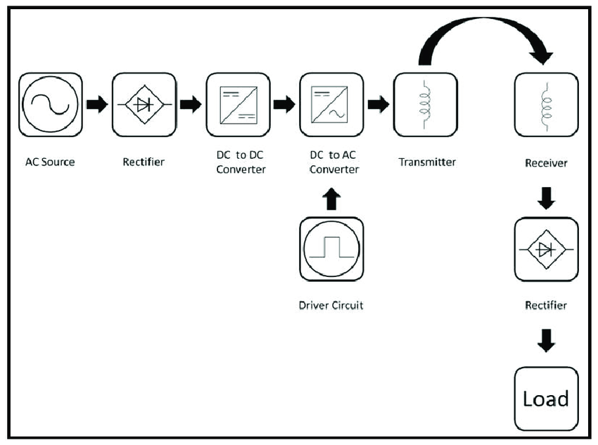
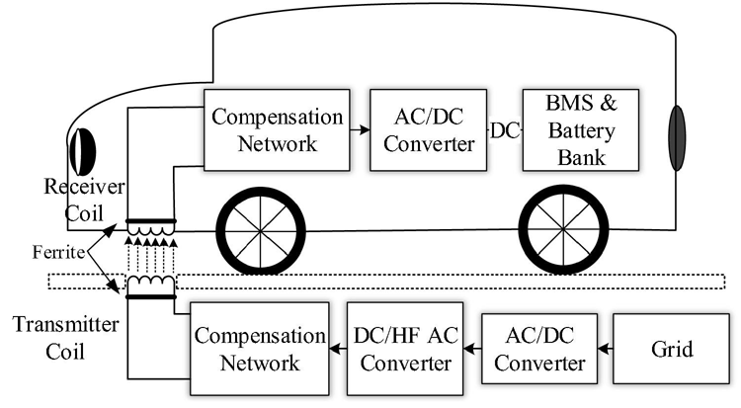
BLOCK DIAGRAM OF STATION VEHICLE

Slide 8
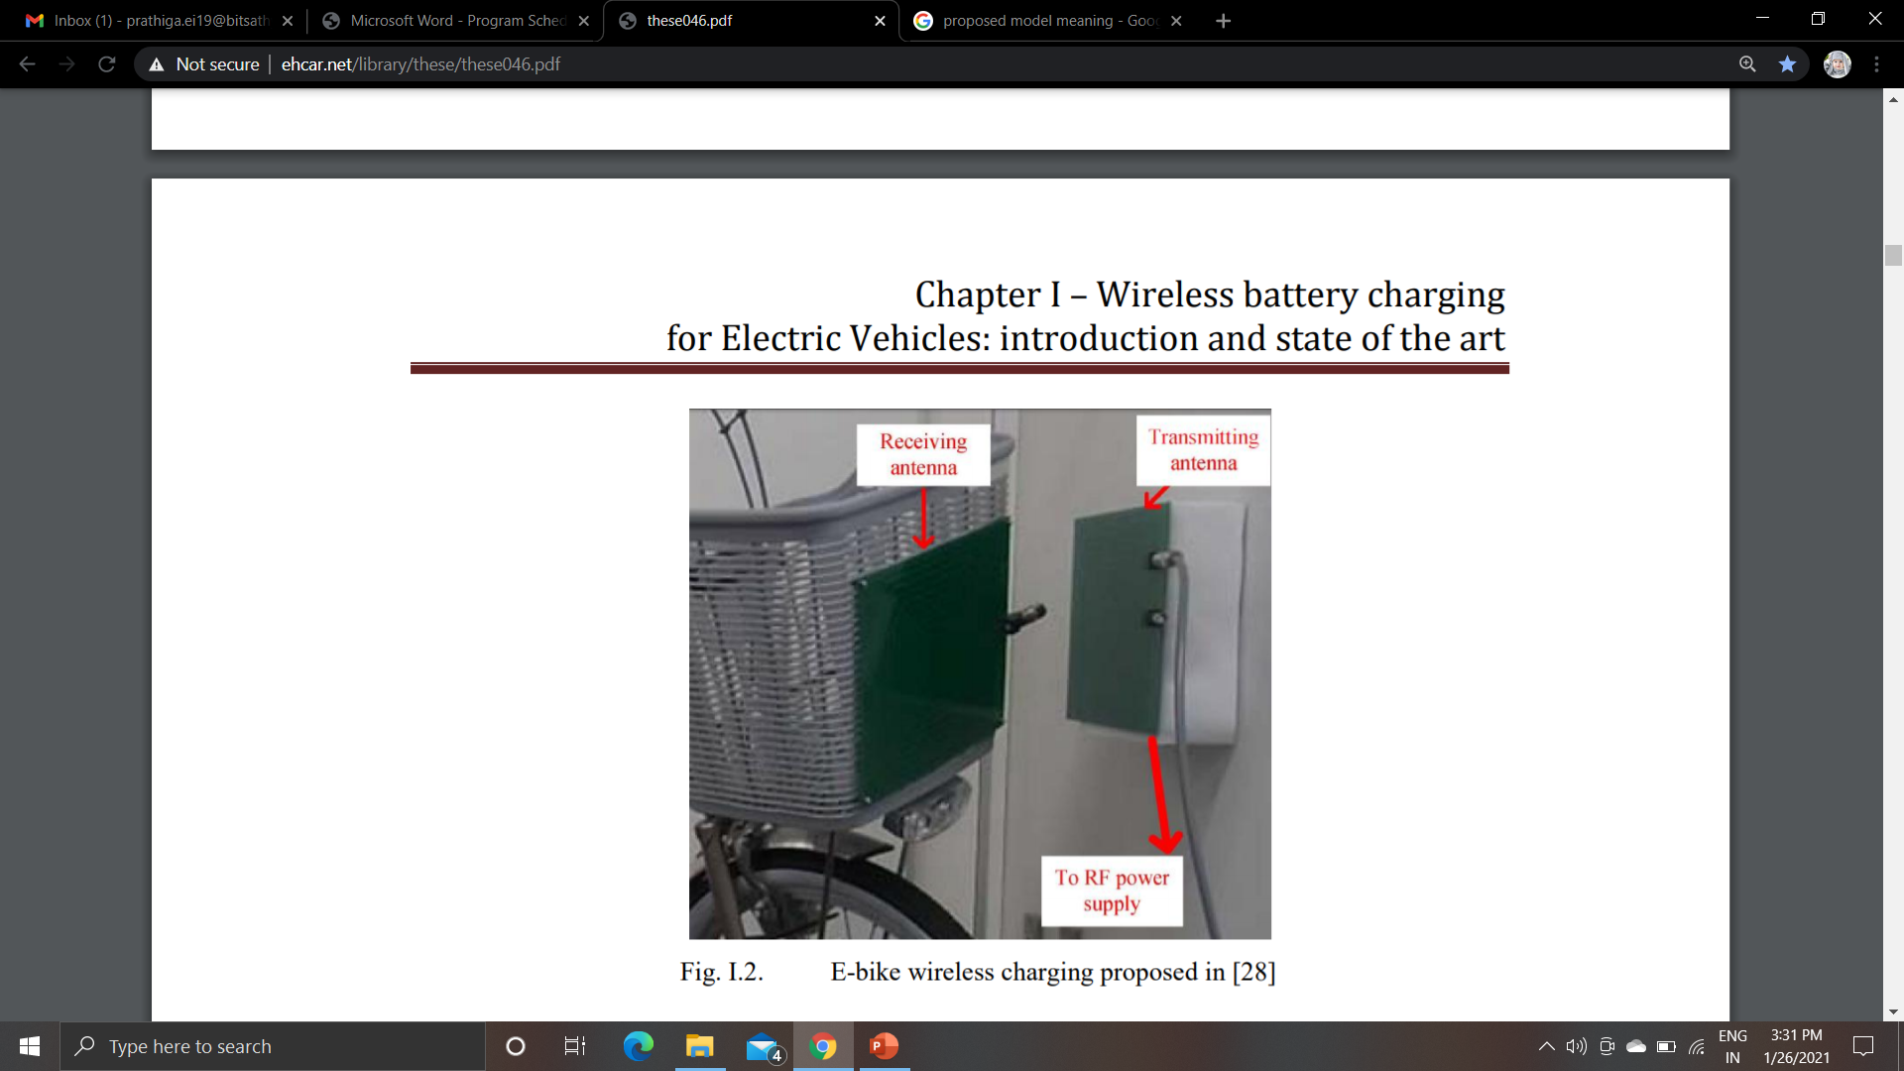
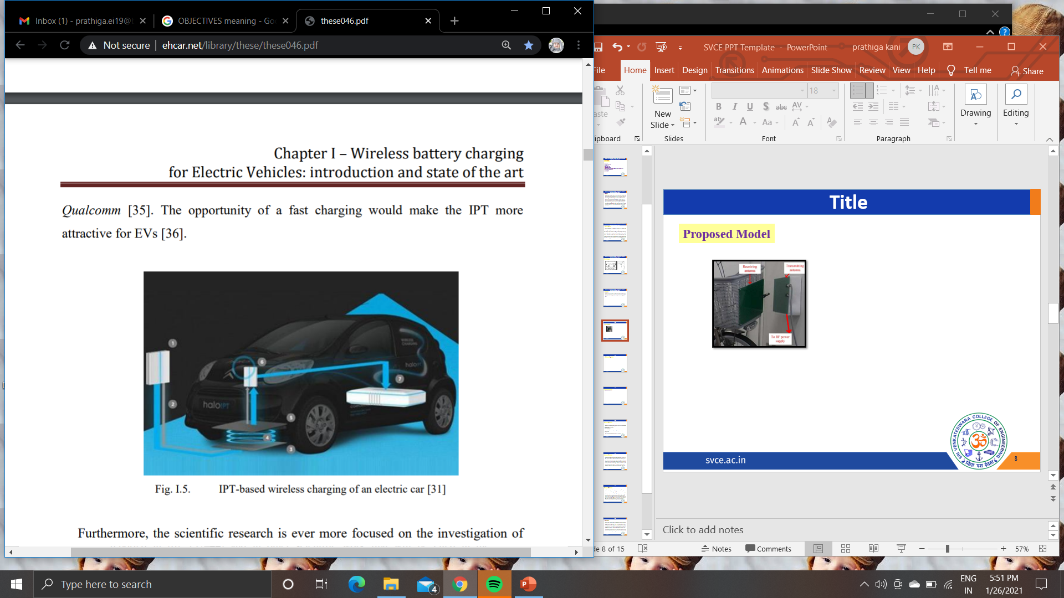
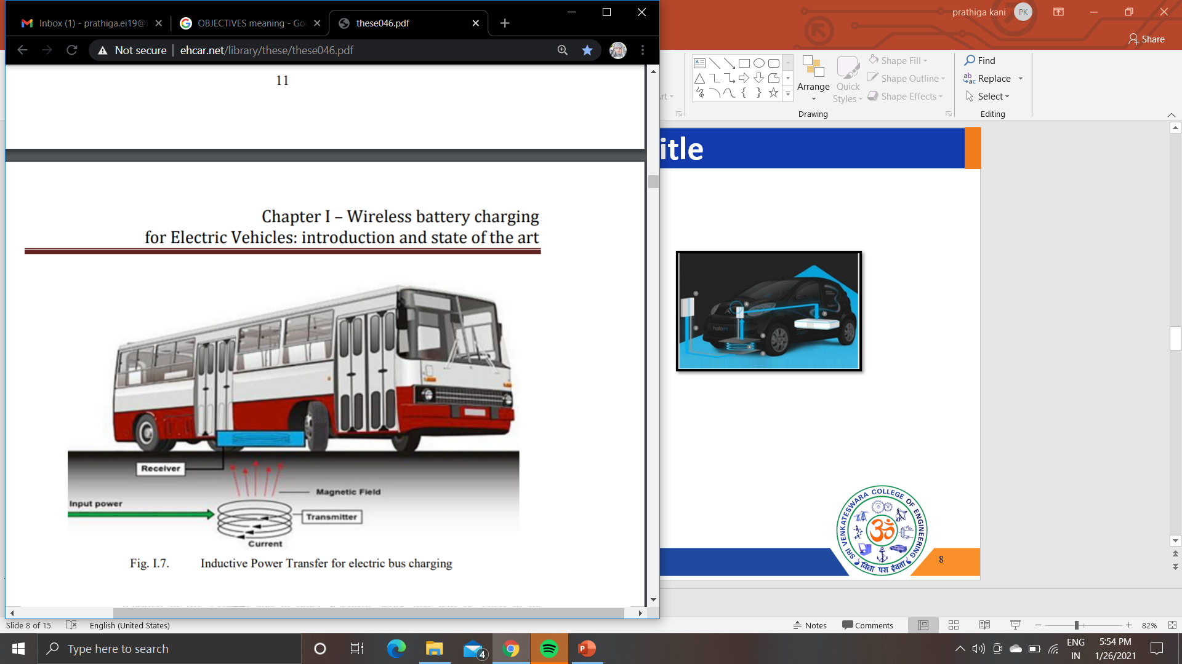
PROPOSED MODEL

Slide 9


SIMULATION/HARDWARE
a DC voltage source, which is used to supply the half-bridge and the MOSFET drivers of the transmitter board;
a function generator which is used to produce the AC waveform driving the MOSFETS, in order to power the primary coil;
a measuring system composed by two voltmeters connected to the terminals of the coils and two current probes, used for the current measurement of both coils;
a power scope, which is used for the real-time waveform detection and measurement of the main electrical quantities involved in the proposed system;
a magnetic probe for the magnetic field characterization of the system
The designed Inductive power transfer system for E-bike battery charging

Slide 10
RESULTS AND DISCUSSION
Challenges and hurdles to the deployment of WEVCS
Though there are plentiful merits to the concept of wireless charging infrastructure, they are equally backed up with a handful of challenges relating to its design, construction, operation and maintenance.
Here, we enumerate the various challenges to set up wireless charging stations in India as in present scenario.
Power Handling Challenges
Challenges relating to power handling can be categorized as:
Smooth power installation systems
Increase in power demands from grids
Its effect on other electricity hungry industries
Intake of energy from the renewable energy sources such as solar and wind power plants, etc., would add new feature to the charging infrastructure i.e., vehicles can give back power to the grid through vehicle to grid application when amount of energy is stored in batteries.
The nanocrystals are formed onto an ordered 3-D
`array with inter-nanocrystals

Slide 11
RESULTS AND DISCUSSION
B. Maintenance issues
Maintenance of such an infrastructure becomes very important, being a costly investment. The major issues are listed below:
Proper equipment handling
Timely replacement of worn out parts.
Periodic checks and assessments.
For India being a densely populated country it is difficult to acquire large land areas at short distance solely for charging of vehicles. To seek an effective solution, parking lots of shopping malls, hotels, large corporate offices, apartments, home garages and other public parking spaces can serve for the purpose. Multi-storied setups can also be constructed to eradicate spacing issues in metropolitans.
Light energy (photons) ionizes the atoms in the silicon and the internal field produced by the junction
separates some of the positive charges (holes)from the negative charges (electrons)
The holes are swept into the p-layer and the electrons are swept into the n-layer
The charges can only recombine by passing through an external circuit outside the material
Power is produced since the free electrons have to pass through the load to recombine with the positive holes

Slide 12
RESULTS AND DISCUSSION
WEVCS creates an innovative way to provide a user friendly environment for users and prevents any safety related problems with the plug-in charging system. Static WEVCS is able to replace easily the plug-in charging system with less driver participation and it is able to solve related safety issues such as trip and electric shock hazards.
The primary coil is usually installed below the electric vehicle’s front, back or center. The energy received from the electric vehicle is first converted from AC to DC by using a power converter and then it is transferred and stored in the battery bank. Power control and battery management systems are linked with a wireless communication network so as to receive any feedback from the primary side, thus it is able to overcome any safety issues.
The charging time of the electric vehicle depends upon the power level of the source, size of the charging pad and air-gap distance between the two windings. In light weight vehicles the average air gap distance between the two coils is about 150–300mm. By a lever mechanism the distance between the coils can be reduced to applicable level. Static WEVCS can be implemented in parking places, car parking facilities, residential areas, commercial and industrial buildings, shopping malls etc.

Slide 13
RESULTS AND DISCUSSION
Two major obstacles suffered by the plug-in hybrid electric vehicles are cost and range. EVs are needed to be charged quite frequently or need to install a larger battery pack which leads to additional issues such cost and weight. Also frequent charging of an electric vehicle is not economical. Thus by implementing dynamic wireless electric vehicle charging system (D-WEVCS) the problems associated with range and cost of electric vehicles can be reduced. Thus D-WEVCS becomes the only answer for future of electric vehicle automation. It is also known as a ‘‘roadway powered”, “on-line” or “in-motion” WEVCS. With high voltage, high frequency AC source and compensation circuits to the micro grid, the primary coils are inserted inside the road surface at a preset distance.
The secondary coil is placed below the vehicles similar to the static-WEVCS. Whenever the electric vehicles passes over the transmitting coil, the vehicle receives a magnetic field through the receiving coil and converts it into DC it is used to charge the battery bank by using the power converter and BMS. When comparing with the current electric vehicles, here by using frequent charging facilities of electric vehicles reduces the overall battery requirement to about 20%. Necessary transmitting coil pads and power supply components need to be installed on specific locations and pre-defined routes. When comparing with the segmented scheme, the centralized scheme has lower efficiency, higher losses, higher installation and maintenance costs. However the initial infrastructure installation of this technology will be expensive. In future with the help of a self-driving vehicles, it would be able to produce perfect alignment between the transmitter and receiver coils, thus it could greatly increase the overall efficiency of the power transfer. Dynamic-WEVCS can be implemented in many electric vehicle transportation applications like light duty vehicles, bus, and rail and for fast transportation.

Slide 14
CONCLUSION
The mobile phone is successfully charged using this hardware prototype of the proposed project. It shows the maximum ground clearance and above it will cause to decrease the efficiency and wireless transmission will not take place. Here we have found out an innovative technology to charge electric vehicles wirelessly through inductive coupling.
In this prototype, when we gave an input voltage of 30V DC we were able to get an output voltage of 5V with 700mA at a distance of 20mm. We can improve the efficiency by following methods, By a lever mechanism we can adjust the distances between receiving and transmitting coils which will increase the power transmission between the coils. By increasing the frequency level to MHz range. By making the system to magnetic resonance coupling.
Increasing the no of turns of the coils by proper coil design. The prototype we made is of lower efficiency because the power input given to the prototype is used for meeting the constant loss as well as magnetic leakage. since the power required for the constant loss and the magnetic leakage will almost remain the same.

Slide 15
REFERENCES
K.A. Kalwar, M. Aamir, S. Mekhilef, Inductively coupled power transfer (ICPT) for electric vehicle charging – a review, Renew. Sustain. Energy Rev. 47 (2015) 462–475. [2]
H. Barth, M. Jung, M. Braun, B. Schmülling, U. Reker, ‘‘Concept Evaluation of an Inductive Charging System for Electric Vehicles”, Presented at the 3rd European Conference Smart Grids and E-Mobility, Munchen, Germany, 2011
M. SangCheol, K. Bong-Chul, C. Shin-Young, A. Chi-Hyung, M. Gun-Woo, Analysis and design of a wireless power transfer system with an intermediate coil for high efficiency, Indust. Electr., IEEE Trans. 61 (2014) 5861– 5870
S. Lukic, Z. Pantic, Cutting the cord: static and dynamic inductive wireless charging of electric vehicles, Electr. Magazine, IEEE 1 (2013) 57–64.
O. H. Stielau and G. A. Covic, “Design of loosely coupled inductive power transfer systems,” in Power System Technology, 2000. Proceedings. PowerCon 2000. International Conference on, 2000, vol. 1, pp. 85–90 vol.1.

Slide 16

QUERIES
????

Slide 17

DONE BY:
SARAVANA.G
NAVEEN KUMAR.V

